Slide 1
CSCI2100D Lab 4
Xin CHEN
Department of Systems Engineering and Engineering Management
Chinese University of Hong Kong

Slide 2
Outline
Unordered Map
Level Order
Graph ADT and DFS
Close Neighbor (Bonus)
Overview of all problems

Slide 3
Hash Table ADT
Operations:
createTable(sizem): create a hash table of size sizem
insert(hashtable, key, value): insert the key value pair to the hashtable.
search(hashtable, key): return the value if the hashtable contains the key, otherwise return NULL
delete(hashtable, key): remove the key and values stored on the hashtable.
isFull(hashtable): return true if no element can be inserted to hashtable, otherwise return false

Slide 4








Collision Resolution: Chaining
Collision: two keys hash to the same slot
Chaining: We place all elements that hash to the same slot into the same linked list
In this lab, our linked list has no head or tail
$h\left(x\right)=x\%3$ (module)
$$T$$
Universe of keys
$$T\left[0\right]$$
$$3$$
Actual keys
$$T\left[1\right]$$
$$1↔7$$
3
$$T\left[2\right]$$
$$2↔5↔8$$
7
1
2
8
5

Slide 5
Unordered Map ADT
Operations:
CreateMap(): create a map which contains a hash table
Size(map): return the number of elements in the map or in the hash table.
Put(map, key, value): insert a key-value pair into the hash table. If the key already exists, update the value.
Get(map, key): return the value of the input key. If there is no such a key, return INF.
Erase(map, key): delete the key from the hash table. If there is no such a key, do nothing.

Slide 6
Tree & Graph
A tree can be regarded as a directed unweight graph
Level 0
Level 1
Level 2
4
4
2
6
2
6
1
3
5
7
1
3
5
7

Slide 7
Level Order Traversal
Level Order Traversal: Traverse nodes from low level to high level. In each level, it always visits nodes from left to right.
Level 0
Level 1
Level 2
4
2 6
1 3 5 7
4 2 6 1 3 5 7
4
2
6
1
3
5
7

Slide 8
Level Order Traversal
Level Order Traversal: Traverse nodes from low level to high level. In each level, it always visits nodes from left to right.
Level 0
Level 1
Level 2
Level 0: Distance(4, 4) = 0
Level 1: Distance(4, 2) = 1
Level 2: Distance(4, 1) = 2
Level order traversal is the same as BFS from the root 4.
4
2
6
1
3
5
7

Slide 9



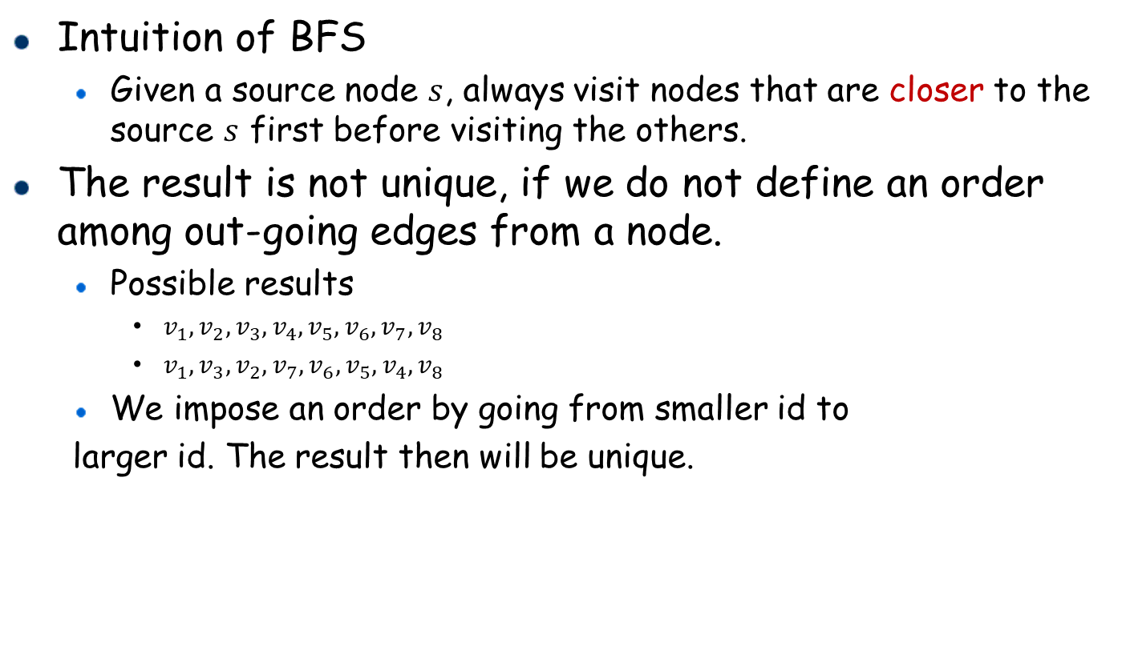






Breadth-First Search (BFS)
Intuition of BFS
Given a source node $s$, always visit nodes that are closer to the source $s$ first before visiting the others.
The result is not unique, if we do not define an order among out-going edges from a node.
Possible results
$v_{1}, v_{2},v_{3}, v_{4},v_{5},v_{6},v_{7}, v_{8}$
$v_{1},v_{3},v_{2}, v_{7},v_{6}, v_{5},v_{4}, v_{8}$
We impose an order by going from smaller id to
larger id. The result then will be unique.
$${ v}_{1}$$
$$v_{2}$$
$${ v}_{3}$$
$${ v}_{4}$$
$${ v}_{5}$$
$${ v}_{6}$$
$${ v}_{7}$$
$$G$$
$${ v}_{8}$$

Slide 10


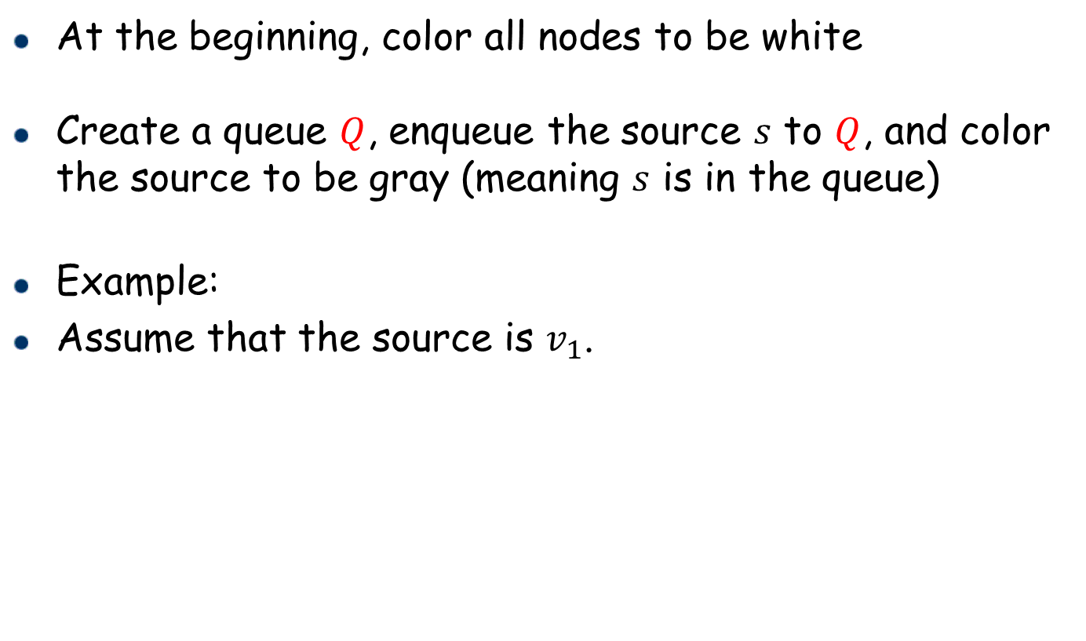
Breadth-First Search (BFS)
At the beginning, color all nodes to be white
Create a queue $Q$, enqueue the source $s$ to $Q$, and color the source to be gray (meaning $s$ is in the queue)
Example:
Assume that the source is $v_{1}$.
$${ v}_{1}$$
$${ v}_{1}$$
$$v_{2}$$
$${ v}_{3}$$
$Q$: $(v_{1})$
$${ v}_{4}$$
$${ v}_{5}$$
$${ v}_{6}$$
$${ v}_{7}$$
$$G$$
$${ v}_{8}$$

Slide 11


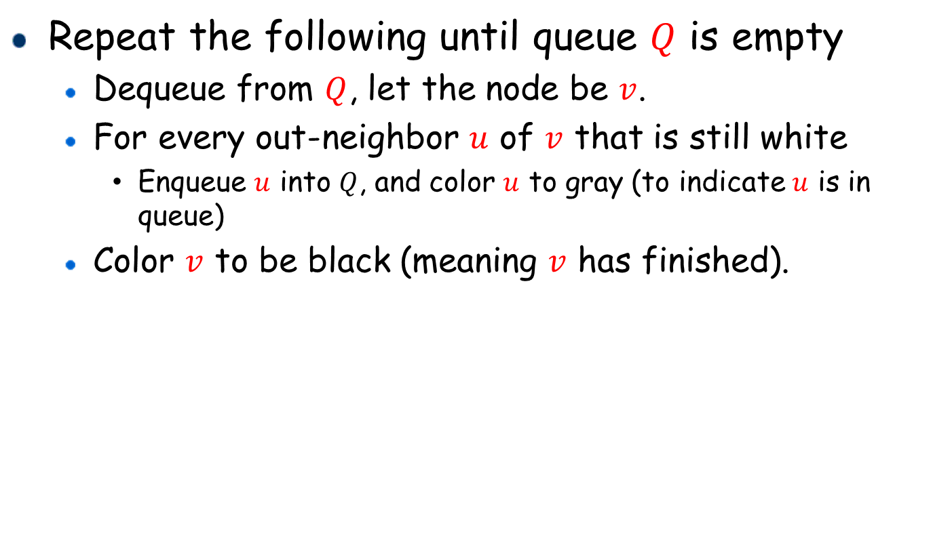




Breadth-First Search (BFS)
Repeat the following until queue $Q$ is empty
Dequeue from $Q$, let the node be $v$.
For every out-neighbor $u$ of $v$ that is still white
Enqueue $u$ into $Q$, and color $u$ to gray (to indicate $u$ is in queue)
Color $v$ to be black (meaning $v$ has finished).
$${ v}_{1}$$
$${ v}_{1}$$
$$Q=(v_{1})$$
$${ v}_{1}$$
After dequeueing $v_{1}$
$$v_{2}$$
$${ v}_{3}$$
$${ v}_{2}$$
$${ v}_{3}$$
$$Q=(v_{2},v_{3})$$
$${ v}_{4}$$
$${ v}_{5}$$
$${ v}_{6}$$
$${ v}_{7}$$
$$G$$
$${ v}_{8}$$

Slide 12




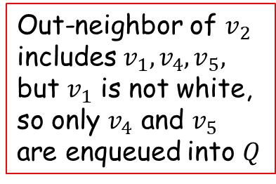
























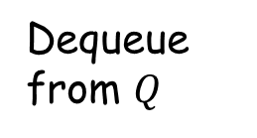






Breadth-First Search: Running Example
$${ v}_{1}$$
$${ v}_{1}$$
$${ v}_{1}$$
Out-neighbor of $v_{2}$ includes $v_{1},v_{4},v_{5},$ but $v_{1}$ is not white, so only $v_{4}$ and $v_{5}$ are enqueued into $Q$
$${ v}_{1}$$
$${ v}_{1}$$
$${ v}_{1}$$
Dequeue from $Q$
$$v_{2}$$
$${ v}_{3}$$
$${ v}_{2}$$
$${ v}_{3}$$
$${ v}_{2}$$
$${ v}_{2}$$
$$v_{2}$$
$${ v}_{3}$$
$${ v}_{3}$$
$${ v}_{4}$$
$${ v}_{5}$$
$${ v}_{6}$$
$${ v}_{7}$$
$${ v}_{4}$$
$${ v}_{4}$$
$${ v}_{5}$$
$${ v}_{6}$$
$${ v}_{7}$$
$${ v}_{5}$$
$$G$$
$$Q=(v_{3},v_{4},v_{5})$$
$${ v}_{8}$$
$$G$$
$$Q=(v_{2},v_{3})$$
$${ v}_{8}$$
$${ v}_{1}$$
$${ v}_{1}$$
$${ v}_{1}$$
$${ v}_{1}$$
Dequeue from $Q$
Dequeue from $Q$
$${ v}_{2}$$
$${ v}_{3}$$
$$v_{2}$$
$${ v}_{3}$$
$${ v}_{2}$$
$${ v}_{3}$$
$${ v}_{3}$$
$$v_{2}$$
$${ v}_{3}$$
$${ v}_{3}$$
$${ v}_{4}$$
$${ v}_{4}$$
$${ v}_{4}$$
$${ v}_{6}$$
$${ v}_{7}$$
$${ v}_{5}$$
$${ v}_{6}$$
$${ v}_{7}$$
$${ v}_{4}$$
$${ v}_{5}$$
$${ v}_{4}$$
$${ v}_{6}$$
$${ v}_{7}$$
$${ v}_{5}$$
$${ v}_{6}$$
$${ v}_{7}$$
$${ v}_{5}$$
$$G$$
$$G$$
$${ v}_{8}$$
$$Q=(v_{4},v_{5},v_{6},v_{7})$$
$${ v}_{8}$$
$$Q=(v_{5},v_{6},v_{7})$$

Slide 13




















































Breadth-First Search: Running Example
$${ v}_{1}$$
$${ v}_{1}$$
$${ v}_{1}$$
$${ v}_{1}$$
Dequeue from $Q$
$${ v}_{2}$$
$${ v}_{3}$$
$$v_{2}$$
$${ v}_{3}$$
$${ v}_{2}$$
$${ v}_{3}$$
$${ v}_{3}$$
$$v_{2}$$
$${ v}_{3}$$
$${ v}_{3}$$
$${ v}_{4}$$
$${ v}_{4}$$
$${ v}_{4}$$
$${ v}_{6}$$
$${ v}_{7}$$
$${ v}_{4}$$
$${ v}_{6}$$
$${ v}_{7}$$
$${ v}_{4}$$
$${ v}_{4}$$
$${ v}_{6}$$
$${ v}_{7}$$
$${ v}_{5}$$
$${ v}_{6}$$
$${ v}_{7}$$
$${ v}_{5}$$
$${ v}_{5}$$
$${ v}_{5}$$
$${ v}_{5}$$
$$G$$
$$G$$
$$Q=(v_{6},v_{7},v_{8})$$
$$Q=(v_{5},v_{6},v_{7})$$
$${ v}_{8}$$
$${ v}_{8}$$
$${ v}_{8}$$
$${ v}_{1}$$
$${ v}_{1}$$
$${ v}_{1}$$
$${ v}_{1}$$
$${ v}_{2}$$
$${ v}_{3}$$
Dequeue from $Q$
$$v_{2}$$
$${ v}_{3}$$
Dequeue from $Q$
$${ v}_{3}$$
$${ v}_{2}$$
$${ v}_{3}$$
$$v_{2}$$
$${ v}_{3}$$
$${ v}_{3}$$
$${ v}_{4}$$
$${ v}_{4}$$
$${ v}_{4}$$
$${ v}_{6}$$
$${ v}_{7}$$
$${ v}_{6}$$
$${ v}_{7}$$
$${ v}_{5}$$
$${ v}_{6}$$
$${ v}_{5}$$
$${ v}_{5}$$
$${ v}_{4}$$
$${ v}_{4}$$
$${ v}_{4}$$
$${ v}_{6}$$
$${ v}_{6}$$
$${ v}_{7}$$
$${ v}_{6}$$
$${ v}_{7}$$
$${ v}_{5}$$
$${ v}_{7}$$
$${ v}_{5}$$
$${ v}_{5}$$
$$G$$
$$G$$
$${ v}_{8}$$
$$Q=(v_{7},v_{8})$$
$${ v}_{8}$$
$${ v}_{8}$$
$$Q=(v_{8})$$
$${ v}_{8}$$

Slide 14


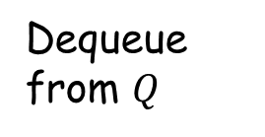




























Breadth-First Search: Running Example
$${ v}_{1}$$
$${ v}_{1}$$
$${ v}_{1}$$
$${ v}_{1}$$
$${ v}_{2}$$
$${ v}_{3}$$
$$v_{2}$$
$${ v}_{3}$$
$${ v}_{3}$$
$${ v}_{2}$$
$${ v}_{3}$$
Dequeue from $Q$
$$v_{2}$$
$${ v}_{3}$$
$${ v}_{3}$$
$${ v}_{4}$$
$${ v}_{4}$$
$${ v}_{4}$$
$${ v}_{6}$$
$${ v}_{6}$$
$${ v}_{7}$$
$${ v}_{6}$$
$${ v}_{7}$$
$${ v}_{5}$$
$${ v}_{7}$$
$${ v}_{5}$$
$${ v}_{5}$$
$${ v}_{4}$$
$${ v}_{4}$$
$${ v}_{4}$$
$${ v}_{6}$$
$${ v}_{6}$$
$${ v}_{7}$$
$${ v}_{6}$$
$${ v}_{7}$$
$${ v}_{5}$$
$${ v}_{7}$$
$${ v}_{5}$$
$${ v}_{5}$$
$$G$$
$${ v}_{8}$$
$${ v}_{8}$$
$$G$$
$$Q=(v_{8})$$
$${ v}_{8}$$
$$Q=()$$
$${ v}_{8}$$
$${ v}_{8}$$
Now $Q$ is empty
BFS finishes

Slide 15
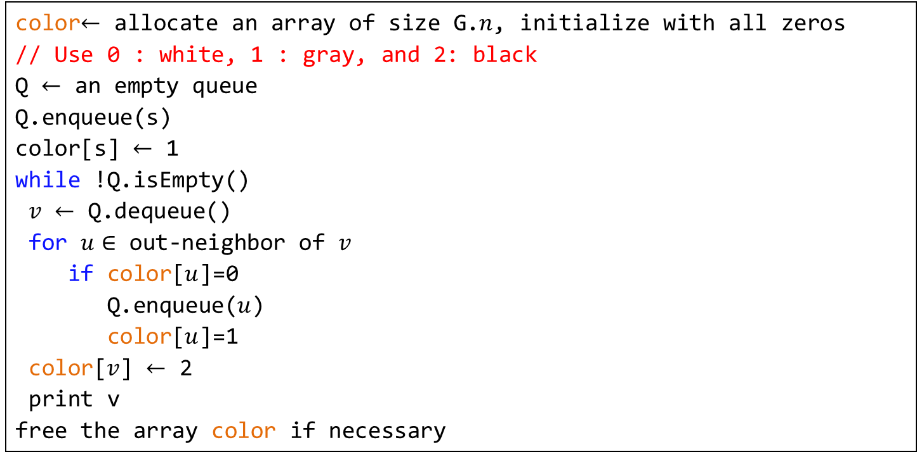
Breadth-First Search: Implementation
Algorithm 1: BFS(G, s)
1
2
3
4
5
6
7
8
9
10
11
12
13
14
color$←$ allocate an array of size G.$n$, initialize with all zeros
// Use 0 : white, 1 : gray, and 2: black
Q $←$ an empty queue
Q.enqueue(s)
color[s] $←$ 1
while !Q.isEmpty()
$v$ $←$ Q.dequeue()
for $u∈$ out-neighbor of $v$
if color[$u$]=0
Q.enqueue($u$)
color[$u$]=1
color[$v$] $←$ 2
print v
free the array color if necessary

Slide 16


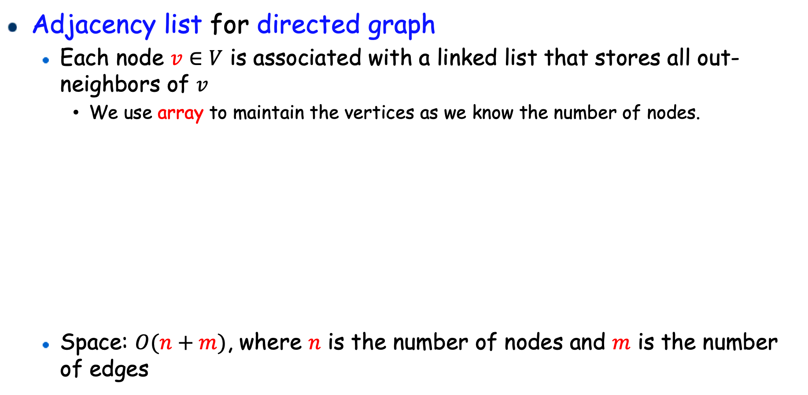






Graph Representation: Adjacency List
Adjacency list for directed graph
Each node $v∈V$ is associated with a linked list that stores all out-neighbors of $v$
We use array to maintain the vertices as we know the number of nodes.
Space: $O(n+m)$, where $n$ is the number of nodes and $m$ is the number of edges
$${ v}_{1}$$
The linked list is different from the previous one!!!
It has no head or tail.
If it is empty, then it equals NULL.
$$v_{1}$$
$$v_{2}$$
$$v_{3}$$
$v_{4}$
$$v_{4}↔v_{2}$$
$$v_{2}$$
$${ v}_{4}$$
$$v_{3}$$
$${ v}_{3}$$
$$NULL$$
$$G$$
$$v_{1}$$

Slide 17
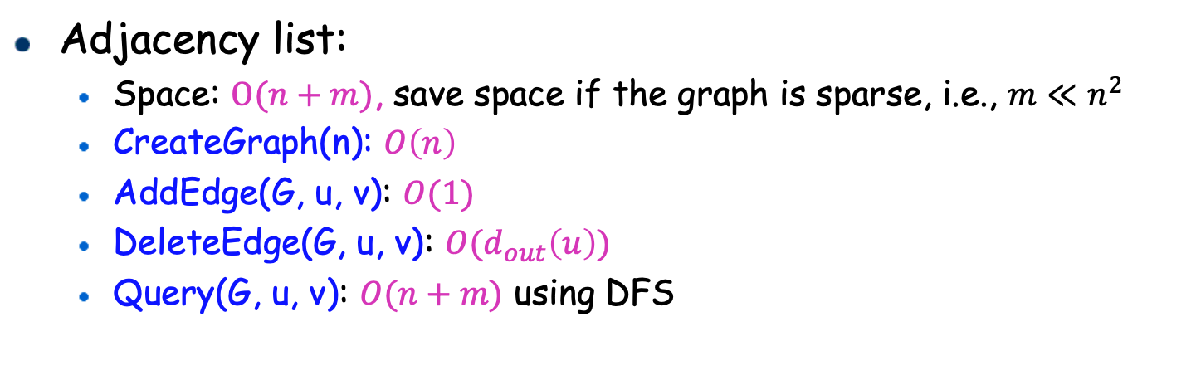
Graph ADT
The graph ADT in this lab supports limited operations:
CreateGraph(n): create a graph with n nodes using the adjacency list
AddEdge(G, u, v): add an edge (u, v) to the graph
DeleteEdge(G, u, v): delete an edge (u, v) from the graph
Query(G, u, v): check whether there is a path from u to v
Adjacency list:
Space: $O(n+m)$, save space if the graph is sparse, i.e., $m≪n^{2}$
CreateGraph(n): $O\left(n\right)$
AddEdge(G, u, v): $O(1)$
DeleteEdge(G, u, v): $O(d_{out}\left(u\right))$
Query(G, u, v): $O(n+m)$ using DFS

Slide 18
Depth-First Search (DFS)
Going along one path until we cannot go further
Imposing an order to make the traversal unique: from smaller id to larger id
Visiting order: $v_{1},v_{2},v_{4},v_{8},v_{5},v_{3},v_{6},v_{7}$
We still focus on directed graph
Extension to undirected graph will be straightforward
$${ v}_{1}$$
$$v_{2}$$
$${ v}_{3}$$
$${ v}_{4}$$
$${ v}_{5}$$
$${ v}_{6}$$
$${ v}_{7}$$
$$G$$
$${ v}_{8}$$

Slide 19



Depth-First Search (DFS)
Initialization:
At the beginning, color all nodes to be white
Create a stack $S$, push the source $s$ to $S$, and color the source to be gray (meaning $s$ is in the stack)
Example:
Assume that $v_{1}$ is the source
$${ v}_{1}$$
$${ v}_{1}$$
$$S=$$
$$v_{1}$$
$$v_{2}$$
$${ v}_{3}$$
$${ v}_{4}$$
$${ v}_{5}$$
$${ v}_{6}$$
$${ v}_{7}$$
$$G$$
$${ v}_{8}$$

Slide 20






Depth-First Search (DFS)
Repeat the following until $S$ is empty.
Get the top node, denoted as $v$, on stack $S,$ do not pop $v$
If $v$ still has white out-neighbors
Let $u$ be such a white out-neighbor of $v$
Push $u$ to $S$, and color $u$ to gray.
Otherwise ($v$ has no white out-neighbors)
Pop $v$ and color it as black (meaning that $v$ has finished)
$${ v}_{1}$$
$${ v}_{1}$$
$$S=$$
$$v_{1}$$
$${ v}_{2}$$
$$v_{2}$$
$${ v}_{3}$$
$$S=$$
$$v_{1}$$ | $$v_{2}$$
$${ v}_{4}$$
$${ v}_{5}$$
$${ v}_{6}$$
$${ v}_{7}$$
$$G$$
$${ v}_{8}$$

Slide 21
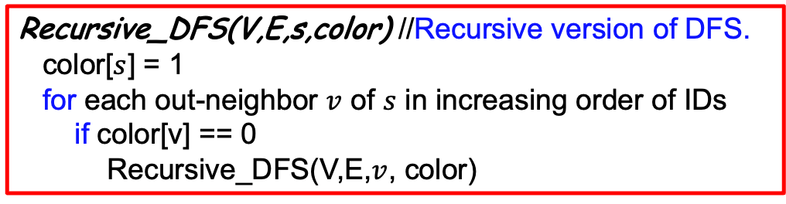
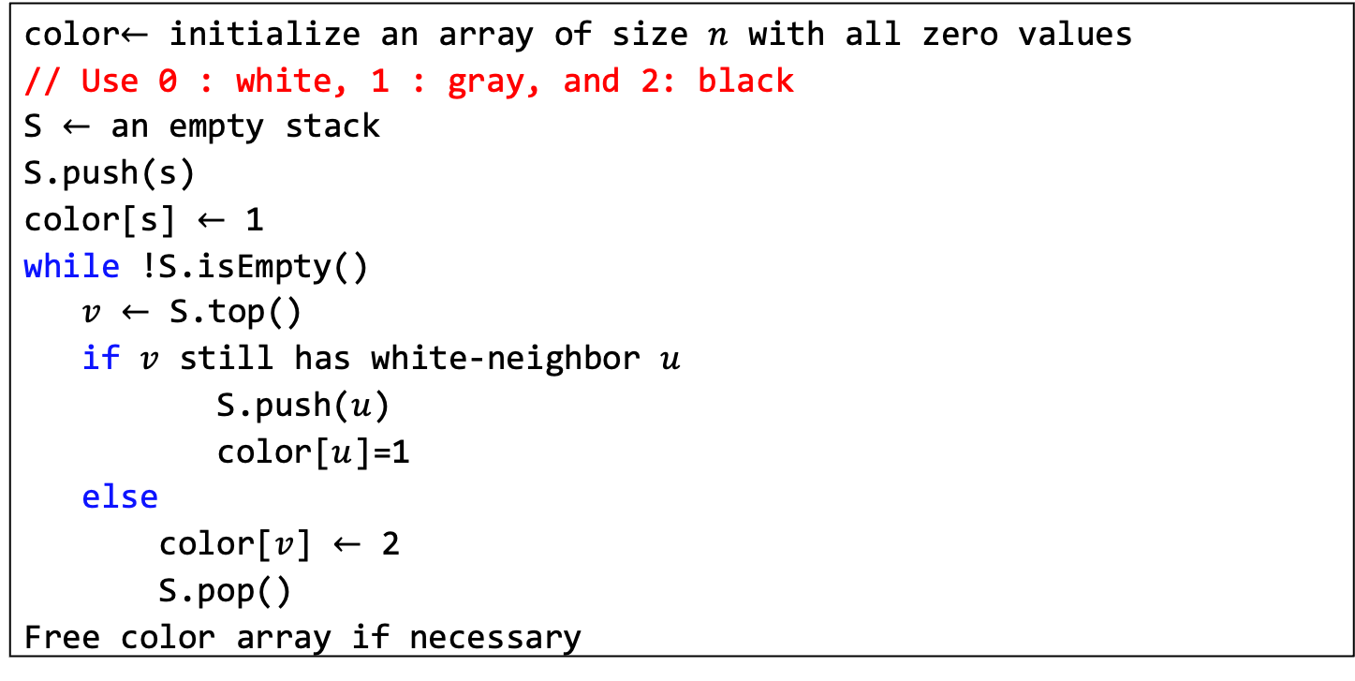
Depth-First Search: Implementation
Algorithm: DFS(V, E, s)
1
2
3
4
5
6
7
8
9
10
11
12
13
14
color$←$ initialize an array of size $n$ with all zero values
// Use 0 : white, 1 : gray, and 2: black
S $←$ an empty stack
S.push(s)
color[s] $←$ 1
while !S.isEmpty()
$v$ $←$ S.top()
if $v$ still has white-neighbor $u$
S.push($u$)
color[$u$]=1
else
color[$v$] $←$ 2
S.pop()
Free color array if necessary
Recursive_DFS(V,E,s,color) //Recursive version of DFS.
color[$s$] = 1
for each out-neighbor $v$ of $s$ in increasing order of IDs
if color[v] == 0
Recursive_DFS(V,E,$v$, color)

Slide 22

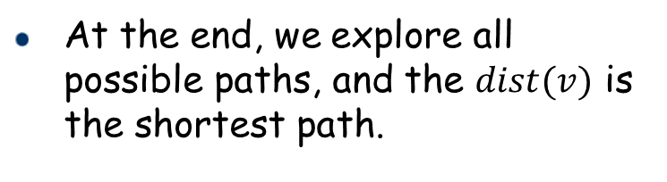


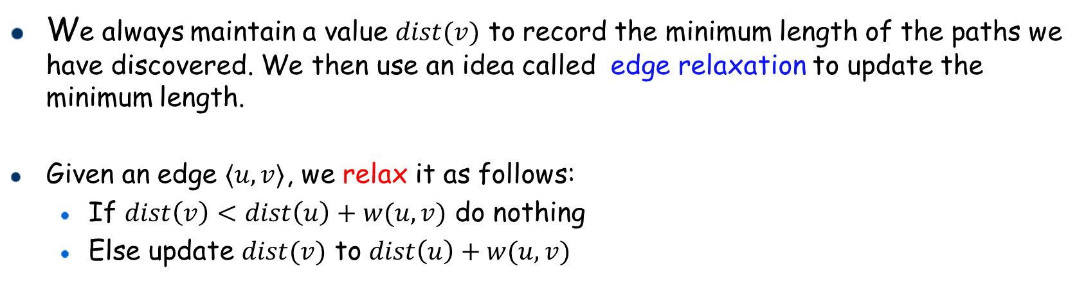




Close Neighbor (Bonus)
Intuition: Start from the source and explore other nodes according to their distances. Always explore from the closest one
We always maintain a value $dist(v)$ to record the minimum length of the paths we have discovered. We then use an idea called edge relaxation to update the minimum length.
Given an edge $〈u,v〉$, we relax it as follows:
If $dist\left(v\right)<dist\left(u\right)+w(u,v)$ do nothing
Else update $dist(v)$ to $dist\left(u\right)+w(u,v)$
next
$$v_{2}$$
6
10
4
4
$$v_{6}$$
At the end, we explore all possible paths, and the $dist(v)$ is the shortest path.
first
2
$$v_{4}$$
$$v_{1}$$
1
3
3
7
6
7
4
$$v_{7}$$
$$v_{3}$$
$$v_{5}$$

Slide 23

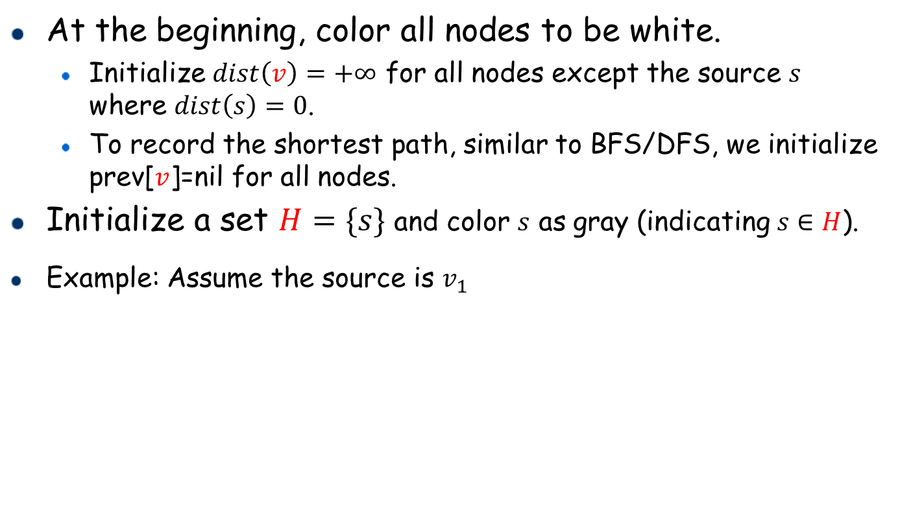
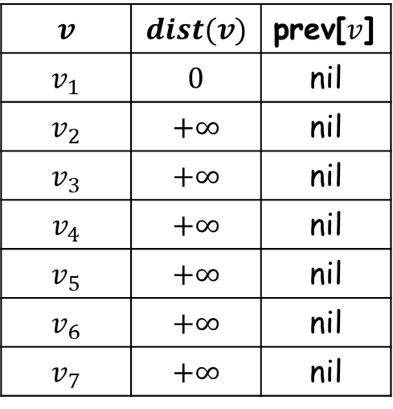

Close Neighbor (Bonus)
At the beginning, color all nodes to be white.
Initialize $dist\left(v\right)=+∞$ for all nodes except the source $s$ where $dist\left(s\right)=0$.
To record the shortest path, similar to BFS/DFS, we initialize prev[$v$]=nil for all nodes.
Initialize a set $H=\{s\}$ and color $s$ as gray (indicating $s∈H$).
Example: Assume the source is $v_{1}$
$$v$$ | $$dist(v)$$ | prev[$v$]
$$v_{1}$$ | $$0$$ | nil
$$v_{2}$$ | $$+∞$$ | nil
$$v_{3}$$ | $$+∞$$ | nil
$$v_{4}$$ | $$+∞$$ | nil
$$v_{5}$$ | $$+∞$$ | nil
$$v_{6}$$ | $$+∞$$ | nil
$$v_{7}$$ | $$+∞$$ | nil
$$v_{2}$$
6
4
10
4
$$v_{6}$$
2
$$v_{4}$$
$$v_{1}$$
$$v_{1}$$
1
3
3
7
6
4
$$v_{7}$$
$H=\{v_{1}\}$
$$v_{3}$$
7
$$v_{5}$$

Slide 24


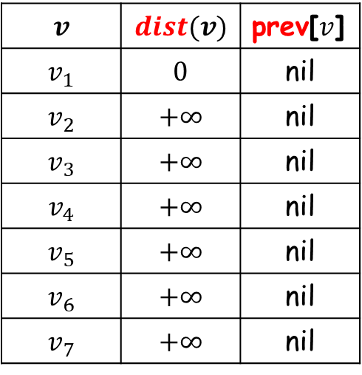













Close Neighbor (Bonus)
Repeat the following until $H$ becomes empty.
Let $u$ be the node with minimum $dist$ value from all nodes in $H$. Remove $u$ from $H$.
For each out-neighbor $v$ of $u$ that is not black, relax edge $〈u,v〉,$ update prev[$v$] to $u$, add $v$ to $H$ and color $v$ as gray if $v∉H$
Mark $u$ as black (indicating $u$ has finished)
See lecture notes for more details.
$dist\left(v_{1}\right)+w\left(v_{1},v_{2}\right)=0+4<dist(v_{2})$
$$v$$ | $$dist(v)$$ | prev[$v$]
$$v_{1}$$ | $$0$$ | nil
$$v_{2}$$ | $$+∞$$ | nil
$$v_{3}$$ | $$+∞$$ | nil
$$v_{4}$$ | $$+∞$$ | nil
$$v_{5}$$ | $$+∞$$ | nil
$$v_{6}$$ | $$+∞$$ | nil
$$v_{7}$$ | $$+∞$$ | nil
$$H=\{v_{1}\}$$
$$v_{2}$$
$$v_{2}$$
6
Remove ${ v}_{1}$
4
10
$$H=\{ \}$$
$v_{2}$
4
${,v}_{3}$
$$4$$
$$v_{1}$$
$$v_{6}$$
2
$$v_{4}$$
$$7$$
$$v_{1}$$
$$v_{1}$$
$$v_{1}$$
$$v_{1}$$
1
3
3
7
6
4
$$v_{7}$$
$$v_{3}$$
$$v_{3}$$
7
$$v_{5}$$
$$dist\left(v_{1}\right)+w\left(v_{1},v_{3}\right)=0+7<dist(v_{3})$$

Slide 25
Declaration
3 Problems (Required) + 1 Problem (Bonus)
Please add this declaration on the top of all your codes submitted to the OJ.
/*
I, <Your Full Name>, am submitting the assignment for
an individual project.
I declare that the assignment here submitted is original except for source material explicitly acknowledged, the piece of work, or a part of the piece of work has not been submitted for more than one purpose (i.e., to satisfy the requirements in two different courses) without declaration. I also acknowledge that I am aware of University policy and regulations on honesty in academic work, and of the disciplinary guidelines and procedures applicable to breaches of such policy and regulations, as contained in the University website http://www.cuhk.edu.hk/policy/academichonesty/.
It is also understood that assignments without a properly signed declaration by the student concerned will not be graded by the teacher(s).
*/

Slide 26
Problem (Unordered Map)
Unordered Map
Use the provided code template, complete the missing part.
Unordered Map
Implement the unordered map ADT with the hash table, where its hashing collision resolution is chaining.
The unordered map ADT has four operations:
Put(key, value): insert a key-value pair into the map. If it already has the key, then update the value.
Get(key): given a key, report its value. If it does not have this key, report INF.
Erase(key): delete this key from the map. If it does not have this key, do nothing.
Size(): report the number of elements inside the map.
Note that the linked list has no head or tail, which means that if this list is empty, then it equals NULL.
Input:
The first line contains one integer: N; The next N lines, each of which contains one of these operations: 1. put key value (two Integers) or 2. get key 3. erase key 4. size
Output:
Each line is the result of get or size.
Sample Input 1:
12
put 0 0
put 29989 29989
get 0
put 0 1
get 0
put 2 2
get 2
size
erase 0
get 0
erase 3
size
Sample Output 1:
0
1
2
3
-1
2

Slide 27
Problem (Unordered Map)
Unordered Map
Provided code.
struct linkedList {
int key;
int value;
struct linkedList* next;
};
typedef struct linkedList* ListNode;
struct map {
int size;
ListNode* hashTable;
};
typedef struct map* MapADT;
// Hash function to map a vertex value to a slot in the hash table
int HashFunction(int key) {
return key % hashTableSize;
}
void Put(MapADT myMap, int key, int value);
void Get(MapADT myMap, int key);
void Erase(MapADT myMap, int key);

Slide 28
Problem (Level Order)
Level Order
Use the provided code template, complete the missing part.
Level Order
Description:
Implement the level order traversal operation of the binary search tree with BFS.
A tree can be regarded as a directed unweighted graph where the direction of each edge is from the low level node to the high level node. By default, we say that the root has the lowest level, 0. And its two children has the level 1, and etc.
Level order traversal technique is defined as a method to traverse a tree such that all nodes present in the same level are traversed completely before traversing the next level.
For each level, it always traverses nodes from left to right. Tips: You should use PrintNode function to print each node.
Input:
The first line contains one integer: N;
The next line contains N Integers, which are used to build the binary search tree.
Output:
The level order traversal sequence.
Sample Input 1:
7
4 2 1 3 6 5 7
Sample Output 1:
4 2 6 1 3 5 7
4
2
6
1
3
5
7

Slide 29
Problem (Level Order)
Level Order
Provided code.
struct treeNode {
int value;
struct treeNode* left;
struct treeNode* right;
};
typedef struct treeNode* TreeNode;
struct queueNode {
TreeNode value;
struct queueNode* next;
struct queueNode* prev;
};
typedef struct queueNode* QueueNode;
struct queue {
int capacity;
QueueNode head;
QueueNode tail;
int size;
};
typedef struct queue* QueueADT;
void PrintNode(TreeNode root) {
if (root != NULL) {
printf("%d\n", root->value);
}
}
// level order traversal
// Use the function PrintNode to print the value in a tree node
// number of nodes is smaller than 20000
void LevelOrder(TreeNode root);

Slide 30
Problem (Graph ADT and DFS)
Graph ADT and DFS
Use the provided code template, complete the missing part.
Graph ADT and DFS
Description:
Implement the graph ADT, which is a directed unweighted graph, using adjacency lists.
This graph ADT supports limited operations as it assumes that the number of nodes is already known.
The graph ADT in this problem has three operations:
AddEdge(u, v): add an edge to the graph
DeleteEdge(u, v): delete an edge from the graph
Query(u, v): check whether there is path from u to v. If there is a path, return 1. Otherwise, return 0.
Note that the linked list has no head or tail, which means that if this list is empty, then it equals NULL.
Input:
The first line contains one integer: N, which is the number of nodes in the graph.
The next line contains one integer: N, which is the number of operations. The next N lines, each of which contains one of these operations: 1. add u v (two Integers) or 2. delete u v (two Integers) 3. query u v (two Integers)
Output:
Each line is the result of the query.
Sample Input:
6
10
add 1 0
add 0 2
query 1 2
query 2 1
add 3 4
add 5 4
add 4 2
query 5 2
delete 4 2
query 3 2
Sample Output:
true
false
true
false

Slide 31
Problem (Graph ADT and DFS)
Graph ADT and DFS
Provided code.
struct linkedListNode {
int id;
struct linkedListNode* next;
};
typedef struct linkedListNode* ListNode;
struct stack {
int capacity;
int* arr;
int size;
};
typedef struct stack* StackADT;
struct graph {
int n;
ListNode* G;
};
typedef struct graph* GraphADT;
void AddEdge(GraphADT myGraph, int u, int v);
void DeleteEdge(GraphADT myGraph, int u, int v);
int Query(GraphADT myGraph, int u, int v);

Slide 32
Problem (Close Neighbor Bonus)
Close Neighbor Bonus
Use the provided code template, complete the missing part.
Close Neighbor (Bonus)
Description (Required):
Given an undirected weighted graph, a source node s, a distance threshold k, report the number of its close neighbors.
If a node u is the close neighbor of s, then the shortest path distance between u and s is no larger than k.
Note that your algorithm must run in O((m+n)*log(n)) time. Besides, please remove any redundant part of your codes and try to make it more efficient. In addition, can you figure out a way to stop early instead of directly calculating the distance between the source node and every other node?
If your algorithm does not meet the above conditions, you may get "Out Of Time".
Input:
The first line contains three integer: n, m, k, which are the number of nodes, the number of edges, and the distance threshold, respectively. The next m lines, each of which contains three integer: u, v, w, where u and v are the node of the edge, and w is the edge weight. The next one line contains one integer: num, which are the number of source nodes The next num lines, each of which contains one integer, which is the source node
Output:
For each source node, print the number of the close neighbors of the source node under the distance threshold.
Sample Input 1:
7 8 3
1 0 4
1 2 1
1 3 5
1 4 4
1 5 4
2 3 1
3 4 1
3 6 2
1
1
Sample Output 1:
3
5
4
0
4
1
1
2
4
5
1
4
1
3
2
6

Slide 33
Problem 4 (Close Neighbor Bonus)
Close Neighbor Bonus
Provided code.
struct node {
int id;
int dis;
};
typedef struct node* Node;
struct Heap {
int capacity;
int size;
Node* arr;
};
typedef struct Heap* HeapADT;
struct edgeNode {
int v;
int weight;
};
typedef struct edgeNode Edge;
Edge graph[MAX_NODES][MAX_NODES];
int edgeNum[MAX_NODES];
int dist[MAX_NODES];
int color[MAX_NODES];
HeapADT myHeap;
int CloseNeighbor(int src, int n, int k);

